Slide 1

2.1 Web Design Tools
Nathaniel Breeden, Bryce Moore, Jonathan Winston, Da'Montaye Snipes, Jeffrey Reigel

Slide 2
Web Serial API
What are some creative uses for the tools/features you’ve selected on a website?
Web serial API is a bidirectional communication interface that allows sending and receiving data byte by byte.
Devices may be connected via a serial port, USB, or Bluetooth devices that emulate a serial port.

Slide 3
Web Serial API
What information could have been added to your selected tools/features based on other sources of information you’ve found?
Web Serial API acts as a bridge between the web and the real world by allowing websites to communicate with serial devices like microcontrollers and 3D printers.
It provides websites a way to read from and write to a serial device with JavaScript.
The API is also a great companion to Web USB as operating systems require applications to communicate with some serial ports using their higher-level serial API rather than the low-level USB API.

Slide 4
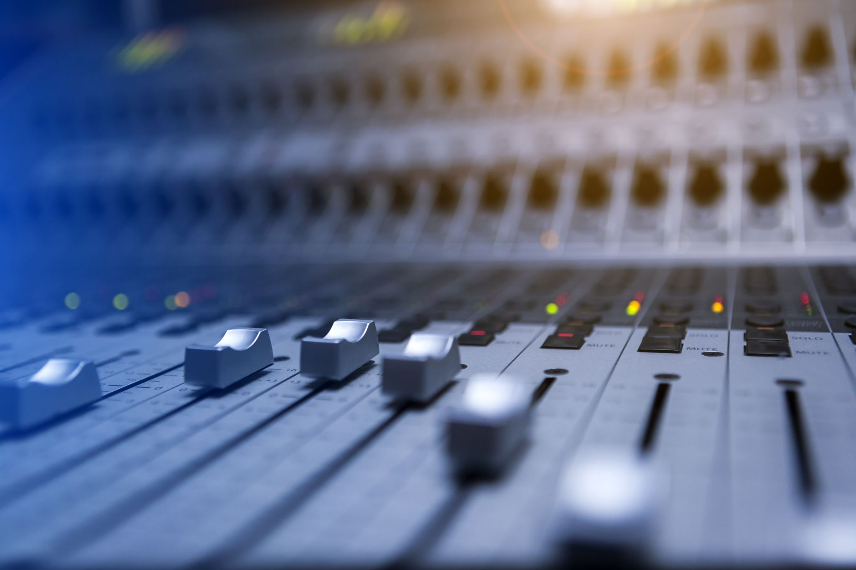
MP3 audio format
What are some creative uses for the tools/features you’ve selected on a website?
The MP3 audio format is used in various ways in our everyday life ranging from listening to music to recording educational information.
MP3 is the most popular Lossy audio formats currently available.
From a development view the use of a MP3 audio file can be helpful on sites to convey information or to possibly help set a mood of a site.
MP3 audio files can also be used for music streaming services.

Slide 5
MP3 audio format
What information could have been added to your selected tools/features based on other sources of information you’ve found?
MP3 stands for MPEG-1 Audio Layer 3
MP3 can be used to compress a full-size uncompressed audio file and if done correctly there is no difference quality wise between the two formats.
At the loss of some sound quality MP3 can be compressed even further to allow a much larger number of files to be stored on a device than if they were kept in their uncompressed format or even higher bit-rate MP3's
Apart from Opera mini the MP3 audio format is supported in the latest version of popular browsers.

Slide 6
References
Web Serial API. (n.d.). https://wicg.github.io/serial/.
Berry, G., & Boutillette, L. (n.d.). The best audio format types for audiophiles. https://www.adobe.com/creativecloud/video/discover/best-audio-format.htm
Deveria. (n.d.). Can I use MP3 audio format. https://caniuse.com/mp3

